Slide 1
Securing Telemetry & Tracing with SPIFFE & Envoy
Sabree Blackmon
@HeavyPackets

Slide 2
Our apps are generating a literal sh*t ton of data

Slide 3
Operational data, such as performance metric and infrastructure or systems logs
Notes:
Such as...

Slide 4
Some of this data is auditable, such as application access logs

Slide 5
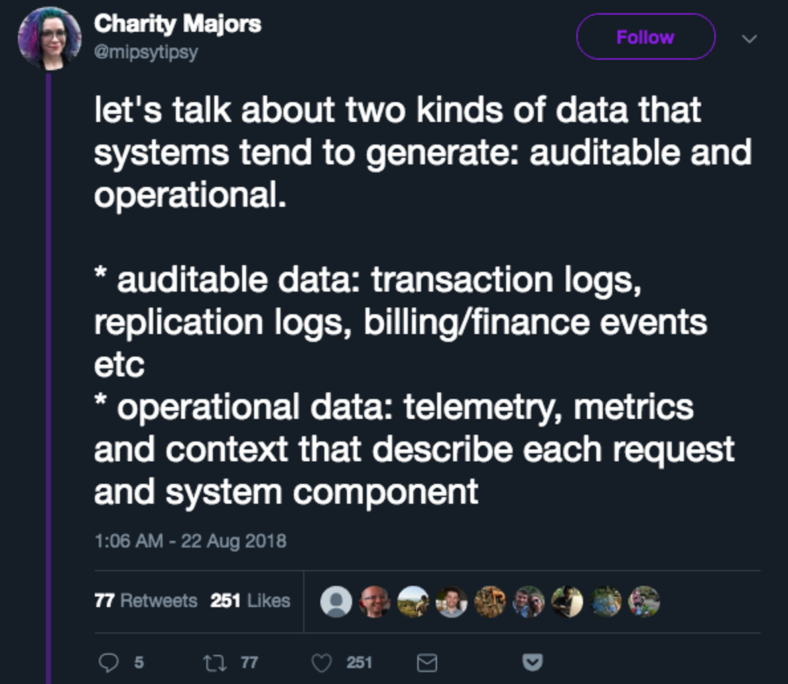
Notes:
Here’s a tweet by Charity majors distinguishing these kinds of data. Both of these kinds of data have interesting AppSec and InfoSec concerns

Slide 6
Engineers, but also auditors, InfoSec teams and BI folks, leverage this data for a diverse set of concerns
Notes:
As such, this data can have a large value footprint to your entire org

Slide 7
But, what happens when this observability data leaks?
Notes:
This could be accidentally to the public, or potentially captured by bad actors. Could this damage your reputation? Or give information to your competators?

Slide 8
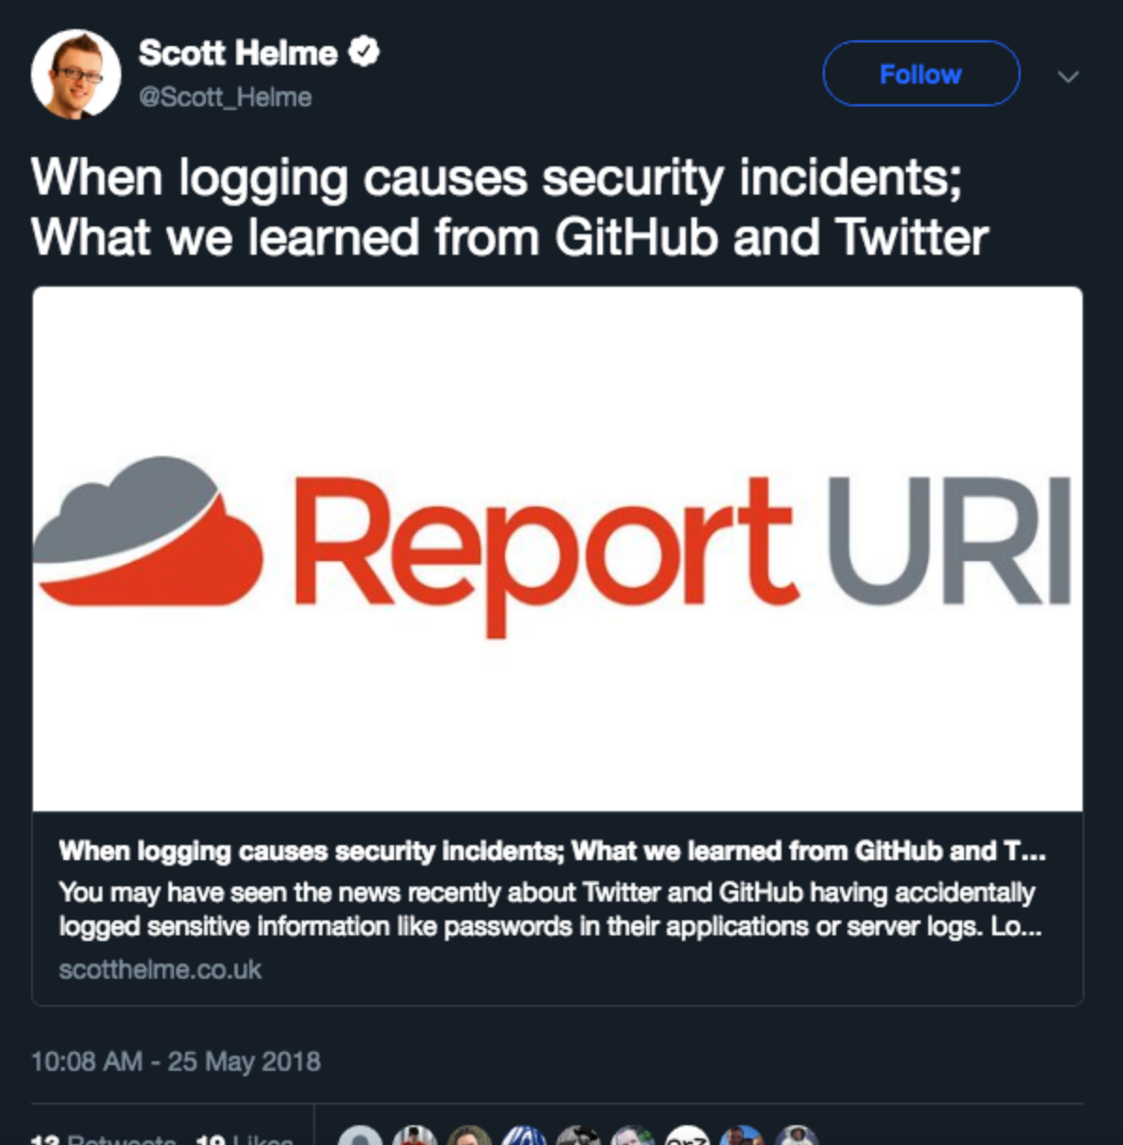
Notes:
ReportURI wrote an interesting piece on recent information password detail leaks from GitHub and Twitter -- this information wasn’t intentionally leaked

Slide 9
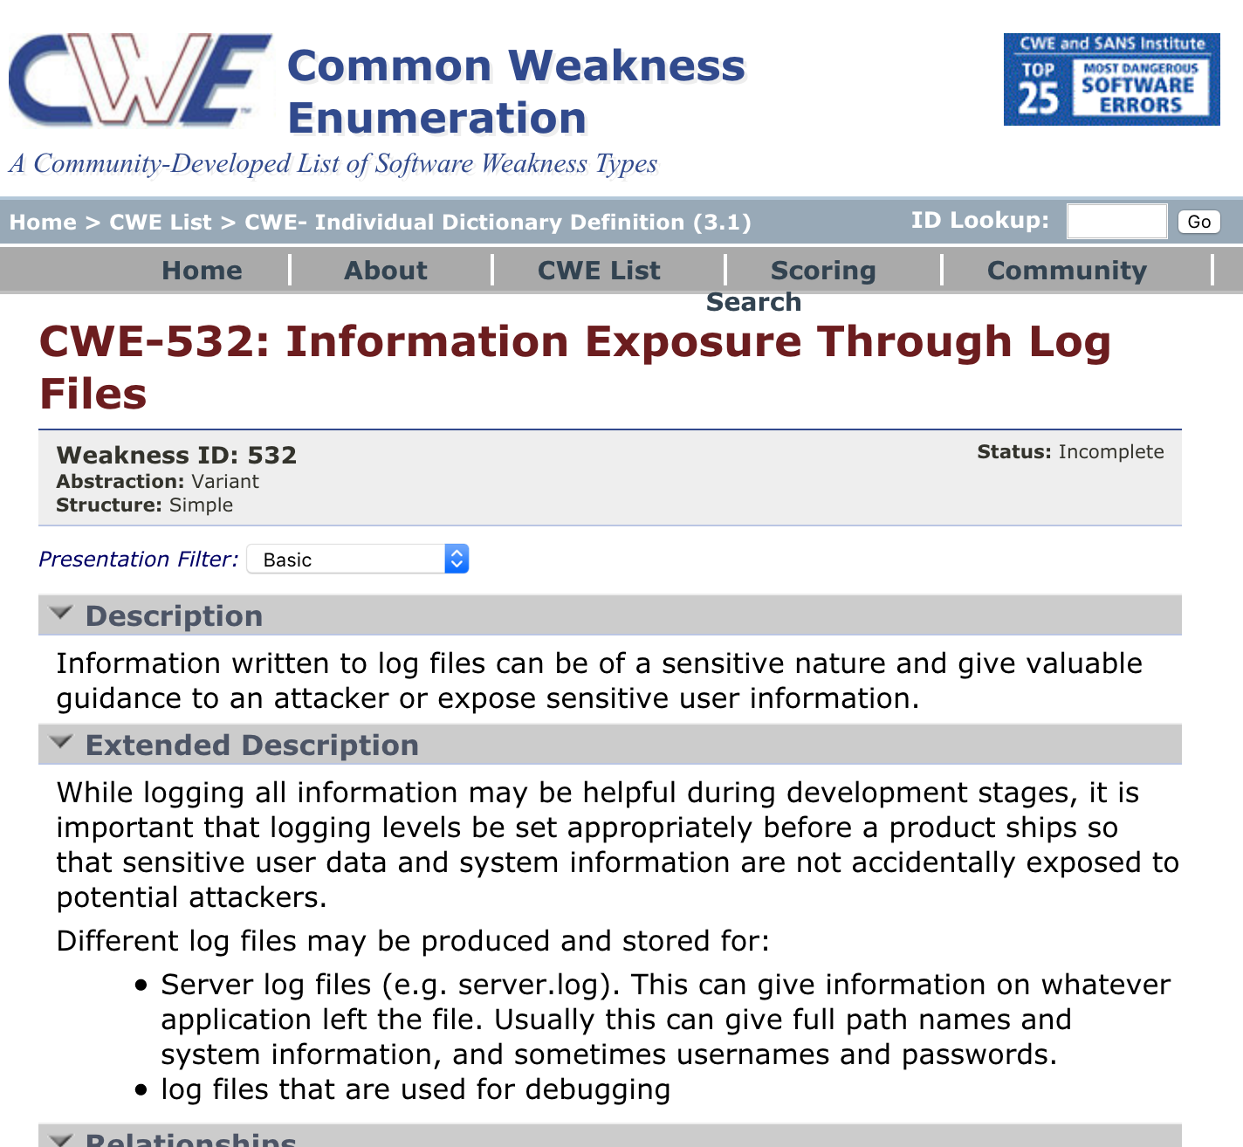
Notes:
This is so common, there’s a common weaknesses enumeration (CWE-532) describing this vulnerability in our applications

Slide 10
We have a great set of open-source observability tools within the CNCF...

Slide 11
...but there isn’t much guidance on how to protect this data in transit
Notes:
This assumes people even know to protect this information in the first place

Slide 12
This data often needs to be secured at rest *too*
Notes:
But that’s a different talk

Slide 13
What are some types of observational data?

Slide 14
Time-series Metrics

Slide 15
Time-series metrics (Telemetry)
Often used for expose runtime performance stats such as memory, CPU load, disk IO, and service request/response metrics
This information can be useful in determining how apps behave in response to API events, time of day, etc
Notes:
Often what we refer to as telemetry

Slide 16
Time-series metrics (Telemetry)
But can be used generically for any kind of metric your applications care about
In our example app, we use time-series data for application access/security statistics
Notes:
\

Slide 17
Text Logging
(structured or unstructured)

Slide 18
Logs give engineers context specific data about events within an application

Slide 19
Logging
Some of this logging is relevant for app debugging purposes
Some of this logging is needed to audit ACLs or security events, data reading/writing, etc

Slide 20
Tracing

Slide 21
Often seen as an extension to logging, it really isn’t

Slide 22
Tracing
Bring together app events across a distributed call stack but also tie in infrastructure specific data into each trace
Proxies (like Envoy) can contribute data to the trace
Things like IP addresses or host information are exposed
Notes:
This makes traces uniquely valuable as infra details are exposed and can provide clues into the physical and virtual networking infra handling a request

Slide 23
Tracing
Important app context specific information can be added to traces
BUT, there is no implied data sanitation or transport safety across trace baggage as it propagates across apps
Notes:
This can make it an improper place to add much detail, or to log auditable data

Slide 24
TL;DR

Slide 25
These tools are all great for debugging and observability purposes...

Slide 26
...but there are important AppSec & InfoSec concerns around *all* of this data

Slide 27
Bad actors can gain valuable introspection into your how applications behave

Slide 28
The cost of info leaks increases the more useful we make our data to engineers
Notes:
As we add detail to make debugging easier, and auditors happy, the more valuable it becomes

Slide 29
Case Study
Example App: A Simple Secrets Server

Slide 30
Simple Rust HTTP API in front of etcd, in which you can store text “secrets”
Notes:
TL;DR -

Slide 31
Simple username & password login, token based API access
Notes:
These tokens are tied to a session that is stored in the etcd KV store

Slide 32
simple-secrets
Metrics (Prometheus) endpoint
Provides a metrics endpoint, that Prometheus scrapes (pulls), that exposes application access statistics
# of valid logins
# of invalid logins
# secrets set
# of sets accessed
Notes:
These metrics enable us to create alarms around irregular access patterns, and also establishes a sort of “heart beat”.
SHOW CODE
SHOW DASHBOARD
Preventing tampering and establishing trust is important

Slide 33
simple-secrets
Logging (Fluentd)
Pushes auditable events to Fluentd:
Logs access events and system errors in detail
As such, valid and invalid user identities are exposed
Notes:
SHOW CODE
SHOW LOGS

Slide 34
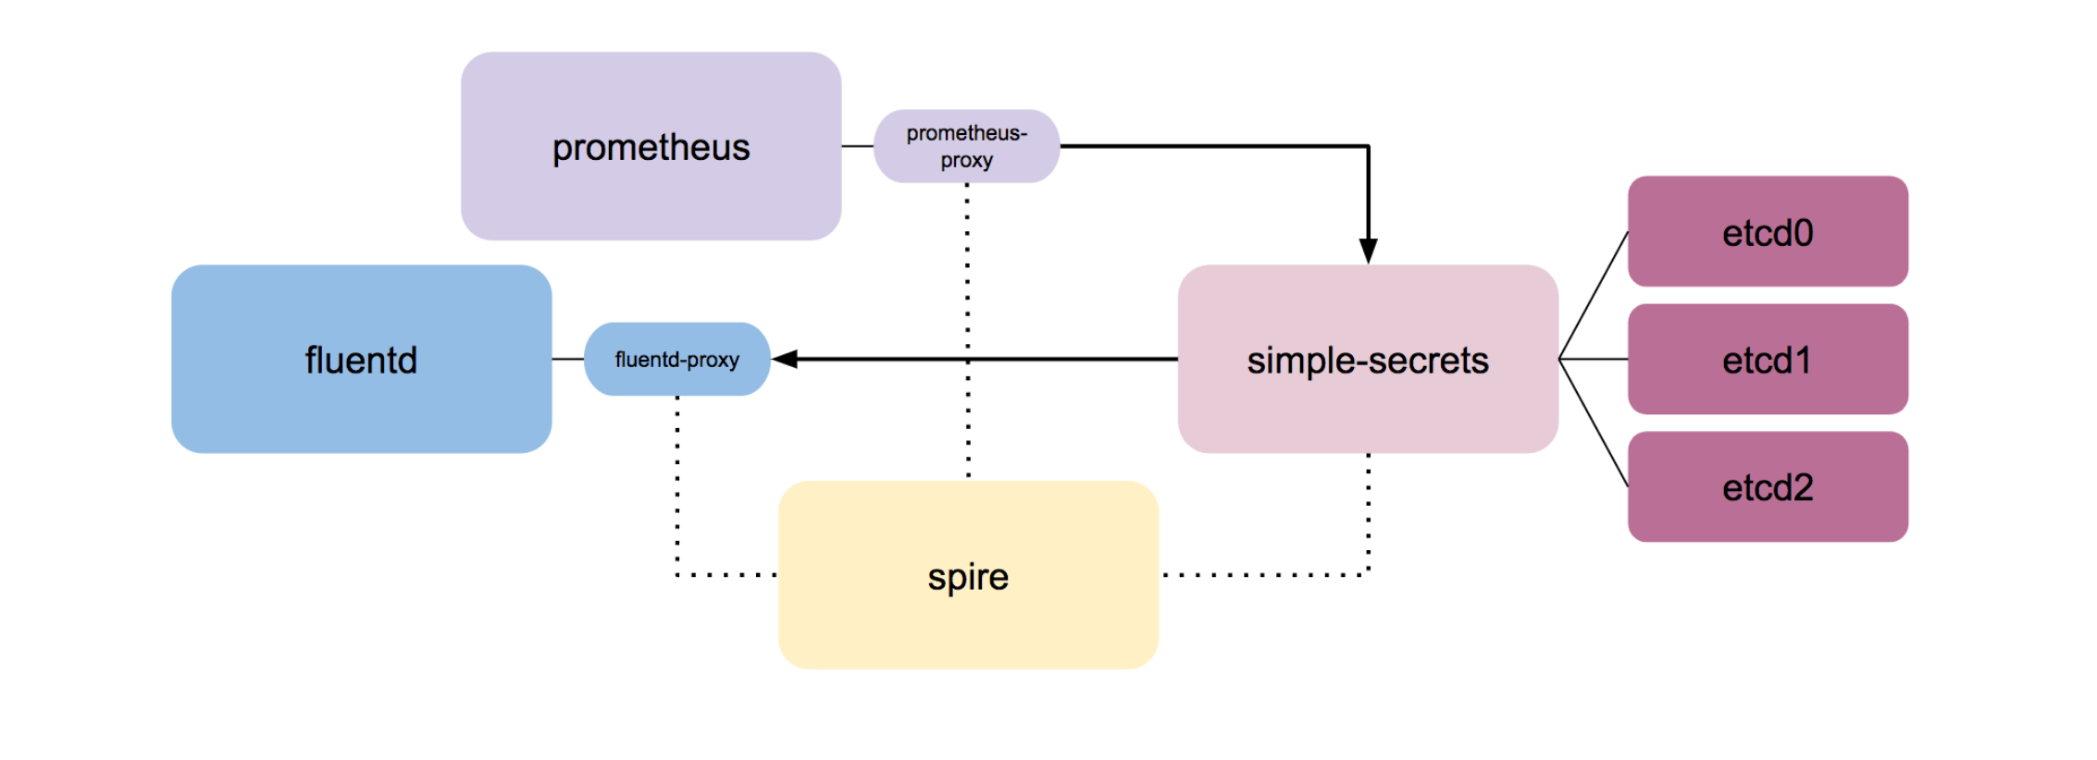
Notes:
A simple architecture diagram, and you can see how Envoy is used as a sidecar proxy

Slide 35


simple-secrets
Envoy & SPIFFE
SPIFFE SVIDs (x509 certificates) are securely issued through a process called attestation with a SPIRE agent
SPIFFE identity are tied to a specific host system
Regularly rotated automatically
Notes:
Show SPIRE rotating certificates
Show Envoy config and highlight SVID validation

Slide 36
simple-secrets
Envoy & SPIFFE
These SVIDs are used by Envoy to establish TLS tunnels between the app and Prometheus + Fluentd
The app knows where data is going to, and the tooling knows what app instance is providing the telemetry
Notes:
Show Envoy config and highlight SVID URI validation

Slide 37
https://github.com/heavypackets/simple-secrets

